Slide 1
DoD Customer Access to DPS with CAC 1) Register for a DPS Account 2) Create Username and Password
DPS User Guide
June 2023

Slide 2
Basic Information
Where to start: You will need to use your CAC to register a new account in DPS
Navigate to the DPS landing page, https://dps.move.mil/cust/standard/user/home.xhtml, and select “Register as a Customer” on the lower left-hand corner of the page.
Fill in the required fields on the registration page, ensuring the primary email is a non-government personal email address, because this is where you will receive all future DPS correspondence during the relocation process. Additionally, ensure dependents can access the primary email addresses to complete DPS actions on your behalf, if needed.
Attach your CAC certificate and select register. Ensure DPS screen returns a screen that states “Account Created”.
After you successfully complete your DPS account registration request, you will receive an auto generated email within one hour with your username and a link to establish a password. This MUST be actioned within 24 hours, to complete the account registration process.
After final registration actions are complete, you can login into DPS any time from a non-CAC enabled device using the username and password option or a CAC enabled device by presenting your certificate.
DPS now requires a CAC at initial registration to safeguard PII and meet security requirements.

Slide 3
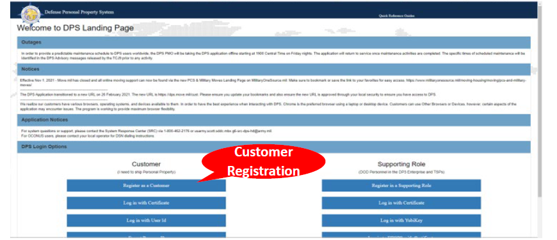
Getting Started

Slide 4
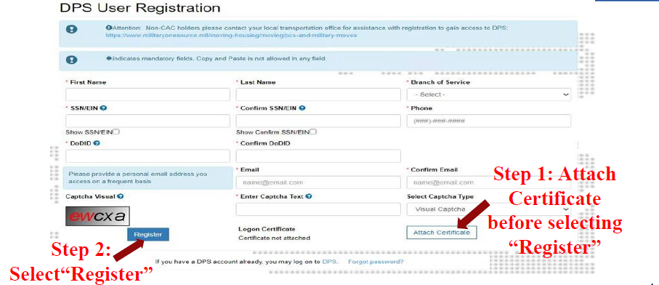
DPS User Registration

Slide 5
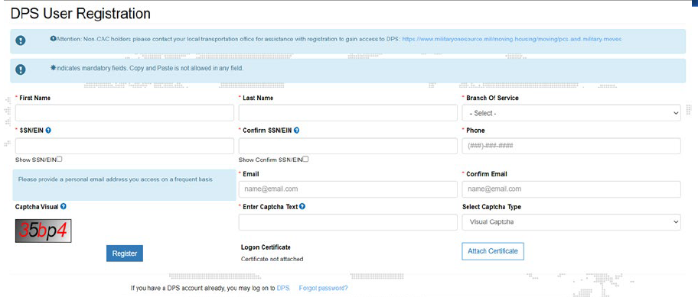
DPS Account Registration

Slide 6
Confirmation
Instructions to Create a Password to Access DPS
Your request has been approved!

Slide 7
Logging In
Click ‘Accept’ button to acknowledge DOD Security Banner.

Slide 8
Logging In
As instructed by the activation email Click “Log in with Certificate”

Slide 9
Logging In
Click ‘Accept’ button to acknowledge DOD Security Banner.

Slide 10
Logging In With User ID
Click “Log in with User ID”

Slide 11
DPS Homepage
(Returning User)
You are required to log in every 30 days to keep the account active. You must review and update your User Profile before each use.
Click “Review User Profile” and the follow the prompts for information.

Slide 12
Services POC
Navy:
Email: householdgoods@us.navy.mil
Phone: 855-HHG-MOVE (855-444-6683)
Marine Corps:
Email: usmcpersonalproperty@usmc.mil
Phone: 703/695-7765
Air Force:
Phone: 210-652-3357 (DSN: 487-3357)
Email: ppahq.ppec.customerservice@us.af.mil
Coast Guard:
Phone: 1-800-462-2176
Web: www.fincen.uscg.mil/dity.htm

Slide 13
Resources
NAVSUP Household Goods Webpage: www.navsup.navy.mil/household
DPS login: https://dps.move.mil/cust/standard/user/home.xhtml
PCS Information: Moving Your Personal Property Landing Page - https://www.militaryonesource.mil/moving-housing/moving/moving-personal-property/
Schedule POV shipment/storage: www.pcsmypov.com
Shipping a POV: http://www.ustranscom.mil/dtr/part-iv/dtr_part_iv_app_k_3.pdf
Storing a POV: http://www.ustranscom.mil/dtr/part-iv/dtr_part_iv_app_k_4.pdf
Personal Property Office Locator: https://installations.militaryonesource.mil/view-all
“It’s Your Move” booklet (Military): https://www.ustranscom.mil/dtr/part-iv/dtr_part_iv_app_k_1.pdf
“It’s Your Move” booklet (Civilian): https://www.ustranscom.mil/dtr/part-iv/dtr_part_iv_app_k_2.pdf
Personal Property Consignment Guide: https://www.ustranscom.mil/dp3/pdfs.cfm

Slide 14
Thank You…….
We hope you have found this presentation informative and helpful.
If you have any suggestions for future topics or if you have any questions regarding the material you have just viewed, please email us at householdgoods@us.navy.mil.

