Slide 1
NSS-SUPPLY
A brief overview of Naval Sustainment System-Supply
13 Nov 2020
Notes:
What is NSS-Supply?
Naval Sustainment System-Supply is simply the Navy’s new supply chain transformation effort.
How is NSS-Supply different from previous approaches to supply chain logistics?
NSS-Supply spans across the broader Navy to review upstream and downstream supply chain inputs that drive readiness.
Readiness is the overarching goal.
While previous efforts have attempted to improve readiness, this approach is more holistic in improving Navy’s supply chain readiness.

Slide 2
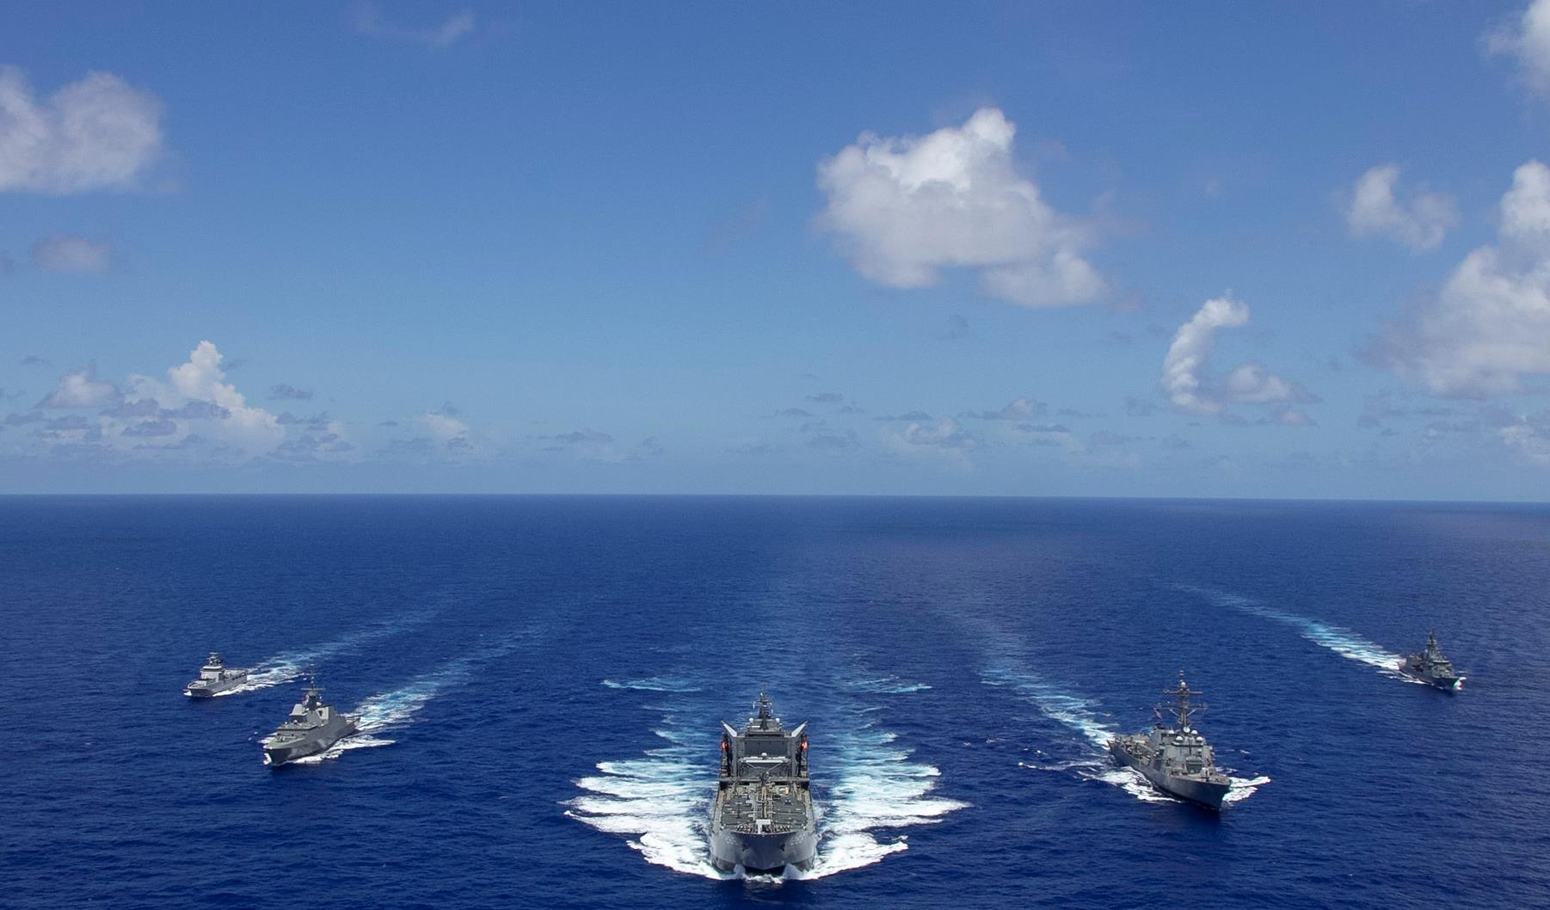
Why NSS-SUPPLY?
We are in an era of great power competition and urgently need to prepare
More steaming days, more underwater days, more ready aircraft
Our supply chains are untimely, costly, and do not generate sufficient readiness
A higher performing Navy needs a new way to manage our supply chains end-to-end (E2E)
2
Notes:
Naval Sustainment System-Supply is the newest NSS.
NSS-Aviation and NSS-Shipyard have already demonstrated success using proven commercial industry “best practice” tailored to the Navy’s specific needs.
Commercial industry has shown us the value of having supply chain managers involved in decisions throughout the organization.
Navy requires a single, strategic-scale, sustainable design for Navy-wide supply chains with the right mix of commercial and organic activities in order to project and sustain the force required for warfighting.
We need to be ready, as around the world opposing nations built their military might and increase threatening activities against US national interests.
NSS-Supply seeks to strengthen Navy’s supply chain in order to increase readiness, thus enhancing combat capability and creating a model of sustainment that will allow the Navy to effectively generate readiness and sustain global navy power.

Slide 3
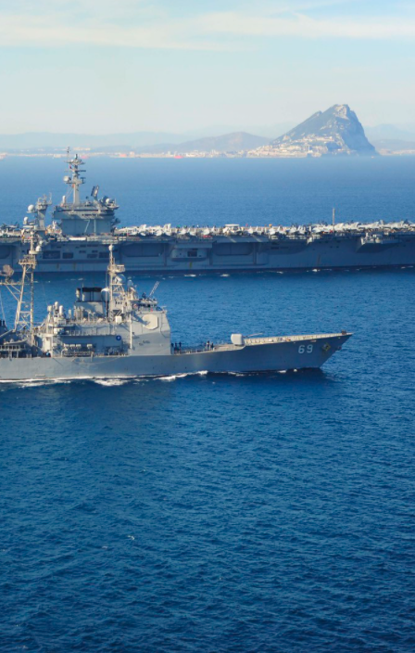
NSS-SUPPLY is a new approach, not a new Mission
A cross-domain "mission partner" approach to coordinate and integrate our supply chains E2E We will take control of our supply chains and, as a leadership team, set the strategic conditions required for mission performance Everyone has a role to play and must act together
Notes:
The Navy’s diverse supply chains are not all “owned” and operated by NAVSUP. We need to partner with the owners and integrate them to achieve a coherent flow from end to end.
NSS-Supply is a cross-functional approach expanding on successful elements of previous NSS/peer-to-peer work, and driven by fleet metrics and supply-specific ‘North Star’ performance and cost targets/metrics.
When we establish expectations and everyone is operating by the same rules, we gain synchronization and are able to perform to those expectations.
To create the supply chain performance the Navy needs, it is imperative that we align and manage all Navy supply chains, end to end, ensuring decision-making is centralized and streamlined.
Moving forward requires an integrated, strategic, approach to Navy-wide supply chains that provides the process capabilities we need to achieve and sustain required mission performance.

Slide 4
NAVSUP designated supported commander for NSS-SUPPLY
We will orchestrate, integrate, and synchronize E2E supply chain performance To accomplish this, NAVSUP will set Pillar targets driven by TYCOM requirements and supply chain effectiveness "North Star" performance This new approach inverts the historical supported/supporting relationships to drive higher supply chain performance E2E
Notes:
We will integrate, synchronize, and orchestrate end to end supply chain performance. To accomplish this, NAVSUP will set Pillar targets driven by TYCOM requirements and supply chain effectiveness "North Star" performance
The Pillars are on the next slide, and the effectiveness North Star on the one after that. This new approach inverts the historical supported/supporting relationships to drive higher supply chain performance end to end.
Success of supporting commanders is based on movement of the supported commander North Star metric.
But first we’ll look at the structure of NSS-Supply and the six pillars.

Slide 5
NSS-SUPPLY will focus on 6 key pillars to drive higher performance
Governance
NSS-SUPPLY and E2E integration
Govern, coordinate, and synchronize strategic supply chain decisions by leadership across Navy.
Achieve E2E integration
Integrate existing Supply Chain resources (i.e., neural network) to sustain the force.
Pillars
Demand Management
Optimize WCF Portfolio
Shape Industrial Base
Optimize Organic
Repair
Increase
E2E velocity
Reduce demand and increase predictability through design, engineering, fleet behaviors, etc.
Take a portfolio approach to managing cash allocation to maximize readiness.
Expand competition with suppliers and deepen partnership with strategic suppliers.
Increase organic depot repair volume to fully utilize capacity
Shorten E2E repair TATs in line with commercial, and move parts in the system faster.
Executive Reliability Control Board (E-RCB), Sustainment Program Baseline (SPB), Maintenance Operations Center (MOC) Aircraft-on-Ground (AOG), NAVSUP WSS Logistics Cell Operations Model (WSS LOGCELL OpModel), NAVSUP BSC, NAVSUP FLCs, supply community, tools for E2E visibility such as: Integrated Supply Chain Management (ISCM), machine learning (ML), Enterprise Resource Planning (ERP), Naval Operational Business Logistics Enterprise (NOBLE).
Enablers
Notes:
We're organizing NSS-Supply into these key six key pillars.
Demand Management, seeks to expand competition with suppliers and deepen partnership with strategic suppliers.
Optimize Working Capital Fund Portfolio, will take a business management approach in managing cash to maximize readiness.
Shape Industrial Base, aims to influence demand and increase predictability through design, engineering, and fleet and industrial behaviors, etc.
Optimize Organic Repair, pursues an increase in organic repair volume by maximizing use of capacity and capability.
Increase End-to-End Velocity, seeks to achieve end-to-end repair turnaround times (no more than 2 times commercial standards) and move parts in the system faster.
Achieve End-to-End Integration, the final pillar above those, will integrate existing supply chain resources to a common goal.

Slide 6
Anatomy of the Figure of Merit (FOM)
=
/
Supply Chain Effectiveness
Value of readiness
Cost to generate readiness
For every dollar put into a weapon system, what is the value of readiness delivered
Value of weapon system(s) that are available:
Total cash put into the weapon system(s)
Value of readiness
Cost to generate readiness
Annualized cost to acquire weapon systems
i.e., the replacement price of an aircraft divided by its service life
X
% of time the aircraft or weapon system is ready
All Costs of Goods Sold (COGS) including:
Commercial repairs & spares, PBLs, spares procured with APN6, TYCOM procurement, I-/D- level labor, DLA warehousing and distribution costs, NAVAIR & NAVSUP overhead, etc.
All inventory costs including:
NAVSUP managed inventory, NAVAIR/NAVSEA managed inventory, and AvCAL/SHORCAL inventory
Annualized cost to acquire weapon systems
Notes:
A new "Supply Effectiveness Figure of Merit" (SEFoM) will be central to this effort and will help balance the readiness achieved vs. the cost to do so; this is a new way of looking at supply chain performance.
The [SEFoM] is a math equation that yields a number that will be applied to supply chain practices and indicates where we can focus our efforts to achieve balance between readiness and cost.

Slide 7
NAVSUP Enterprise Path forward for NSS-SUPPLY
NSS-Supply is not new work, but a new approach to the work we are already doing
NSS uses data and analytics to identify the key drivers of performance in a given area and is already positively impacting readiness in the fields of aviation and shipyard maintenance.
Then, business best practices are applied to make permanent changes in how Navy modernizes, maintains, operates, man, trains, and supports the force to achieve lasting increases in readiness.
Notes:
Through NSS, data and analytics are used to continuously reevaluate performance, and project future performance, with the goal of cementing gains and creating a culture of continuous improvement and accountability.

