Slide 1
NAVSUP WSS
Post Award Orientation Conference
(PAOC)

Slide 2


Ronald Cross Eugene Short Jr.
Quality Assurance Representative Quality Assurance Subject Matter Expert
EXTBE Team Mission Assistance Group
Defense Contracts Management Agency
Naval Special Emphases Operations

Slide 3
PAOC Seminar Objectives
What is a PAOC? Full/Limited
When is a PAOC required?
PAOC Types and “Drivers”
Why should a Contractor participant in a PAOC?
Importance of Contract Technical Review

Slide 4
What is a PAOC
FAR Subpart 42.5…
Definition: “A conference, letter or other form of written communication which aids both the Government and Contractor personnel in achieving a clear and mutual understanding of all contractual requirements [and responsibilities.”
Conducted after contract award.

Slide 5
Subpart 42.5—Postaward Orientation
42.500 Scope of subpart.
This subpart prescribes policies and procedures for the postaward orientation of contractors and subcontractors through—
(a) A conference; or
(b) A letter or other form of written communication.

Slide 6
FAR 42.501 General.
42.501 General.
Postaward orientation aids both Government and contractor personnel to (1) achieve a clear and mutual understanding of all contract requirements, and (2) identify and resolve potential problems.
  It is not a substitute for fully understanding the work requirements at the time offers are submitted.
  It is not to be used to alter the final agreement arrived at in any negotiations leading to contract award

Slide 7
What is a POAC
In other words, Post contract receipt & review meeting, to ensure mutual understanding of the contractual requirements.
  What are the requirements?
  How are the requirements going to be accomplished?
  Customer hold points
  Subcontracting
  Pre-production requirements
  Controls
  Documentation
  Packaging
  Inspection & Test
  Delivery

Slide 8
Types of PAOCs
Two Types of PAOCs used by DCMA to ensure product quality compliance throughout the manufacturing performance stage of the procurement.
  Formal / Full
    Determined by the assigned Contracting Officer
    Directed by the NSEO Commander
  Limited / QA
    Determined by QA Personnel

Slide 9
PAOC Process for a
Formal PAOC
42.503-1 Postaward conference arrangements.
(a) The contracting officer who decides that a conference is needed is responsible for—
(1) Establishing the time and place of the conference;
(2) Preparing the agenda, when necessary;
(3) Notifying appropriate Government representatives (e.g., contracting/contract administration office) and the contractor;
(4) Designating or acting as the chairperson;
(5) Conducting a preliminary meeting of Government personnel; and
(6) Preparing a summary report of the conference.
(b) When the contracting office initiates a conference, the arrangements may be made by that office or, at its request, by the contract administration office.

Slide 10
PAOC Process for a
QA (Limited) PAOC
QA Only PAOC
DCMA-INST-327 QA/Limited the Government Quality Assurance Representative,
  Plans for a Limited / QA PAOC
  Schedule
    Invite CMO / Customer personnel
  Prepare the agenda
  Conduct Gov’t meeting prior to PAOC
  Conduct the PAOC (May be conducted via teleconference)
  Prepares and distributes the report
  Follow-up

Slide 11
When is a PAOC Required
If required by contract.
If required by the Contracting Officer.
When DCMA performs the Contract Technical Review, a request can be issued to the ACO, or PCO (Contracting Officers) recommending a formal PACO. If the Contracting elects not to proceed, a QA only PAOC is required to address the quality concerns.

Slide 12
Why perform a PAOC
By now we clearly understand why. To:
  Address all concerns
  Mutually understand the requirements
  Understand the expectations
  Understand the steps necessary to achieve the expected outcome.
  Satisfy customer requirements/expectations
  Meet delivery requirements
  Deliver conforming high quality supplies to our Warfighters

Slide 13
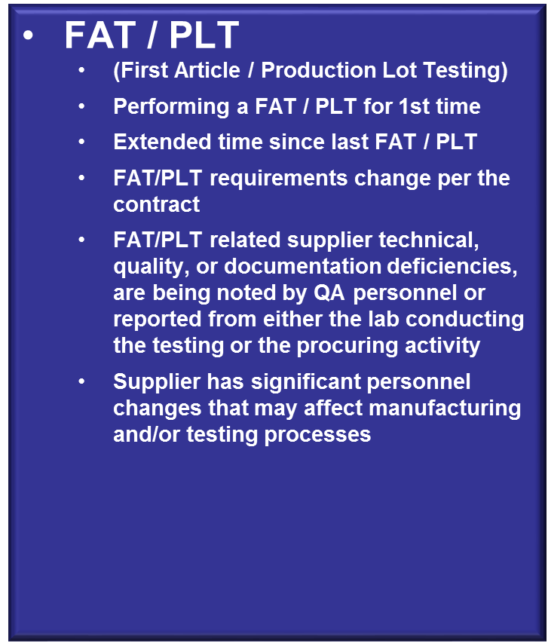
PAOC “Drivers”
New Supplier
Adverse Quality History
Adverse Performance History
Overhaul / Repair
Negative PAS
ALRE CSI

Slide 14
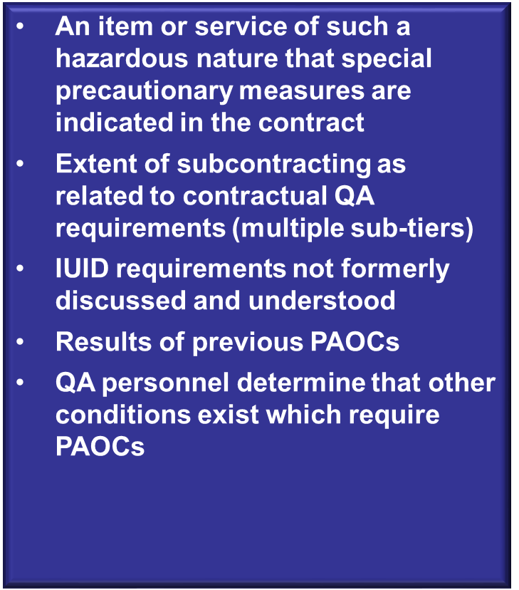
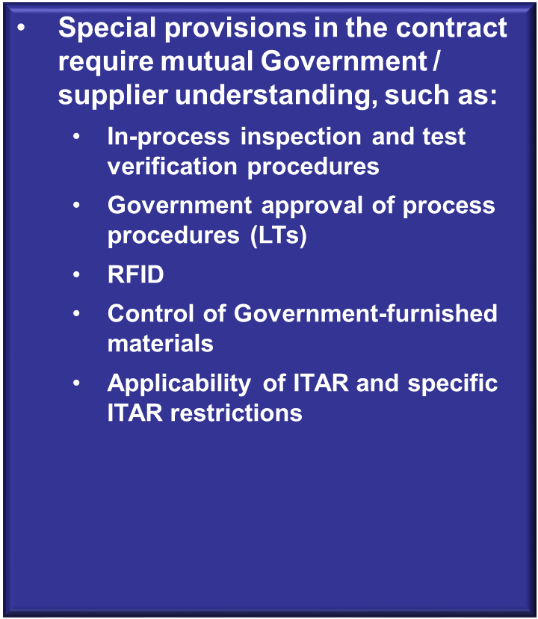
Other PAOC “Drivers

Slide 15
What makes PAOC important?
I’m glad you asked….
“footstomp” Video or Photo(s)

Slide 16
Contract Technical Review
CTR is Critical to PAOC…
WHY??
During a CTR, contractual requirements and responsibilities are reviewed…
Because…

Slide 17
Contract Technical Review
“The Contractor is responsible for performing or having performed all inspections and tests necessary to substantiate that the supplies or services furnished…conform to contract requirements, including any applicable technical requirements for specified manufacturers’ parts.”
Reference
FAR 52.246

Slide 18
Contract Technical Review
Question: How can contractors successfully perform all contractual manufacturing, technical, and quality requirements without understanding the contract?
Answer: They cannot! (fade in after question)

Slide 19
Contract Technical Review
Remember, the PAOC is about achieving a mutual understanding of the contract requirements.
Communication between each process input owner, helps achieve that mutual understanding and results in accomplishing a compliant process output. Therefore, in the next few slides, your customer, the Navy has identified Specific items of Interest, that will be communicated to you.

Slide 20
Contract Technical Review
Clauses of Specific Interest to Navy Nuclear
Specialty Metals
Buy American Act
RFID vs. IUID

Slide 21
Contract Technical Review
Clauses of Specific Interest to Navy Nuclear
Specialty Metals 252.225-7008 Restriction on Acquisition of Specialty Metals. ..... (b) This clause implements 41 U.S.C chapter 83, Buy American. .... (b) Subject to the restrictions in section 225.872 of the Defense FAR Supplement, the Contractor shall not ...

Slide 22

Contract Technical Review
Clauses of Specific Interest to Navy Nuclear
Buy American Act
The Buy American statute (formerly the Buy American Act, 41 U.S.C. § 10a–10d) was passed by U.S. Congress in 1933. The purpose of the Buy American statute is to provide preferential treatment for domestic sources of supplies, manufactured goods, and construction material for public use unless a specific exemption applies.

Slide 23
Contract Technical Review
Clauses of Specific Interest to Navy Nuclear
Buy American Act
The statute requires the federal government to purchase domestic supplies for use in the United States, if— (a) The supply contract exceeds the micro-purchase threshold; or (b) The supply portion of a contract for services that involves the furnishing of supplies exceeds the micro-purchase threshold. In determining what are domestic goods, the place of mining, production, or manufacture is controlling. The Buy American statute has separate provisions for supply contracts and construction contracts, and applies to small business set-asides.

Slide 24
Contract Technical Review
Clauses of Specific Interest to Navy Nuclear
RFID Radio Frequency Identification
An automatic identification and data capture technology comprised of one or more reader/interrogators and one or more RF transponders in which data transfer is achieved by means of suitably modulated inductive or radiating electromagnetic carriers.
IUID Item Unique Identification
A system of establishing unique item identifiers (UII) within the DoD by assigning a machine-readable character string or number to a discrete item, which serves to distinguish it from other like and unlike items. (Ref: MIL-STD-130N Change 1)

Slide 25
Contract Technical Review Elements
Contract and Contract modification
Drawings and Revisions
Specifications, Standards, QML/QPL (Qualified Manufacturer's List/Parts List)
Data Requirements
Additional Factors
  Pre-award Surveys (PAS)
  Past Performance Information (PPI) / DC&A
  Any other available records

Slide 26
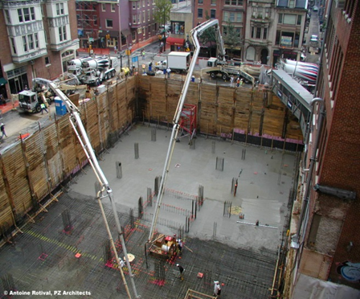

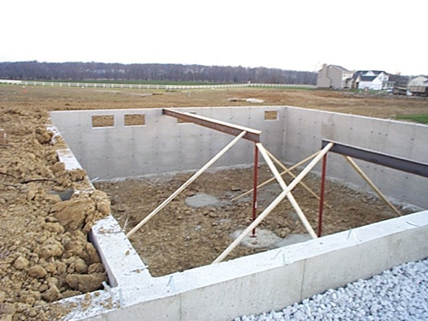


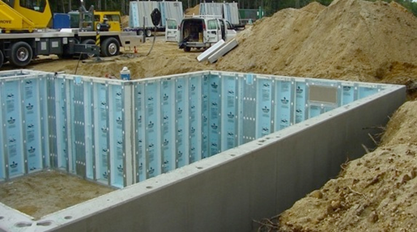
Contract Technical Review

Slide 27
Contract Technical Review
Effects of Poor CTR Review…
ESCAPES, PRODUCT QUALITY DEFICIENCIES, CUSTOMER COMPLAINTS, CONTRACT NON-COMPLIANCES, MISSED DELIVERY DATES
MISSION FAILURE

Slide 28
Contract Technical Review “Bottom Line”
In short…
GET TO KNOW YOUR CONTRACT BY PERFORMING A THOROUGH CONTRACT TECHNICAL REVIEW!!!!

Slide 29
PAOC Topics of Discussion
Inspection / Acceptance Point – D/D or S/D
iRAPT requirements (Invoicing, Receipt, Acceptance, Property Transfer – formerly WAWF)
Preservation, Packaging, Packing & Marking *
  (*Key area of concern)
  Adequate or not ?
  Where performed?
  Missing / confusing requirements

Slide 30
PAOC Topics of Discussion
Part Marking *
  (*Key area of concern)
  Trace Code
  Other Required Marking (per drawing/ spec / IRPOD)
  Method of Marking (i.e. MIL-STD-792, MIL-STD-129)
  IUID
SMICs
Mercury Exclusion

Slide 31
PAOC Topics of Discussion
Contract data package requirements *
  (*Key area of concern)
  Material & Test Certifications /
  Reports of Test Inspection (ROTI)
  Letters of Transmittal (Pre-production or Pre-manufacturing Procedures
  Certificates of Compliance
  Shelf Life Certifications

Slide 32
PAOC Topics of Discussion
Supplier’s obligation to provide facilities and inspection equipment for Government QA personnel to perform surveillance
Any specific requirements for personnel certification i.e. NDT, Welding…
Special process controls for material treatments that cannot be verified through subsequent inspections or tests i.e. Heat Treat, Plating…

Slide 33
PAOC Topics of Discussion
Government Hold Points !!!!!!
  Hold or Notification !!! (Surveillance, Inspection, Testing)
  Provide copy to Supplier
Counterfeit Material
Inspection / Acceptance
  Contract Materials (product) & Contract Data

Slide 34
PAOC Topics of Discussion
Any ambiguous quality or technical requirements
  Waiver / Deviation Process
  PCO / ACO only can change the contract
Contractor access to PDREP & PPIRS
NOFORN Document Control (“Not Releasable to Foreign Nationals”)
  iRAPT – Do Not attach !!!
  E-mail – Do not Attach !!!
NOTE: Pending Contract modification, “Nothing discussed during this meeting shall be construed as a change to the contract”

Slide 35
Documenting the PAOC
The NSEO QA PAOC checklist will be used to document either a Full or Limited (QA) PAOC
Documentation shall included
  PAOC discussion topics
  List of attendees
  Agreements

Slide 36
PAOC Documentation
  Decisions
  Action items
    Clearly specify the individual(s)
    An estimated completion date.
  Any other pertinent information
  Note: The documented meeting minutes must be formally acknowledged by the contractor's point of contact indicating concurrence with the content.

Slide 37
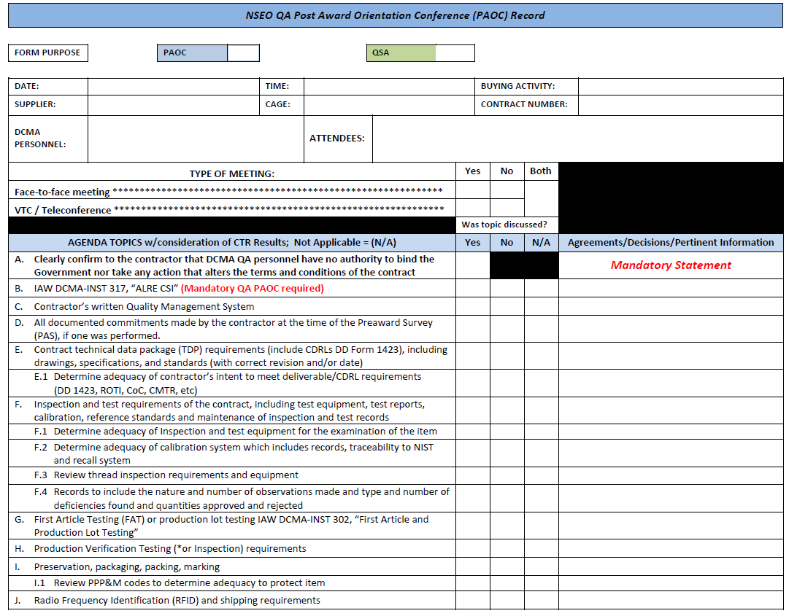
PAOC Documentation

Slide 38
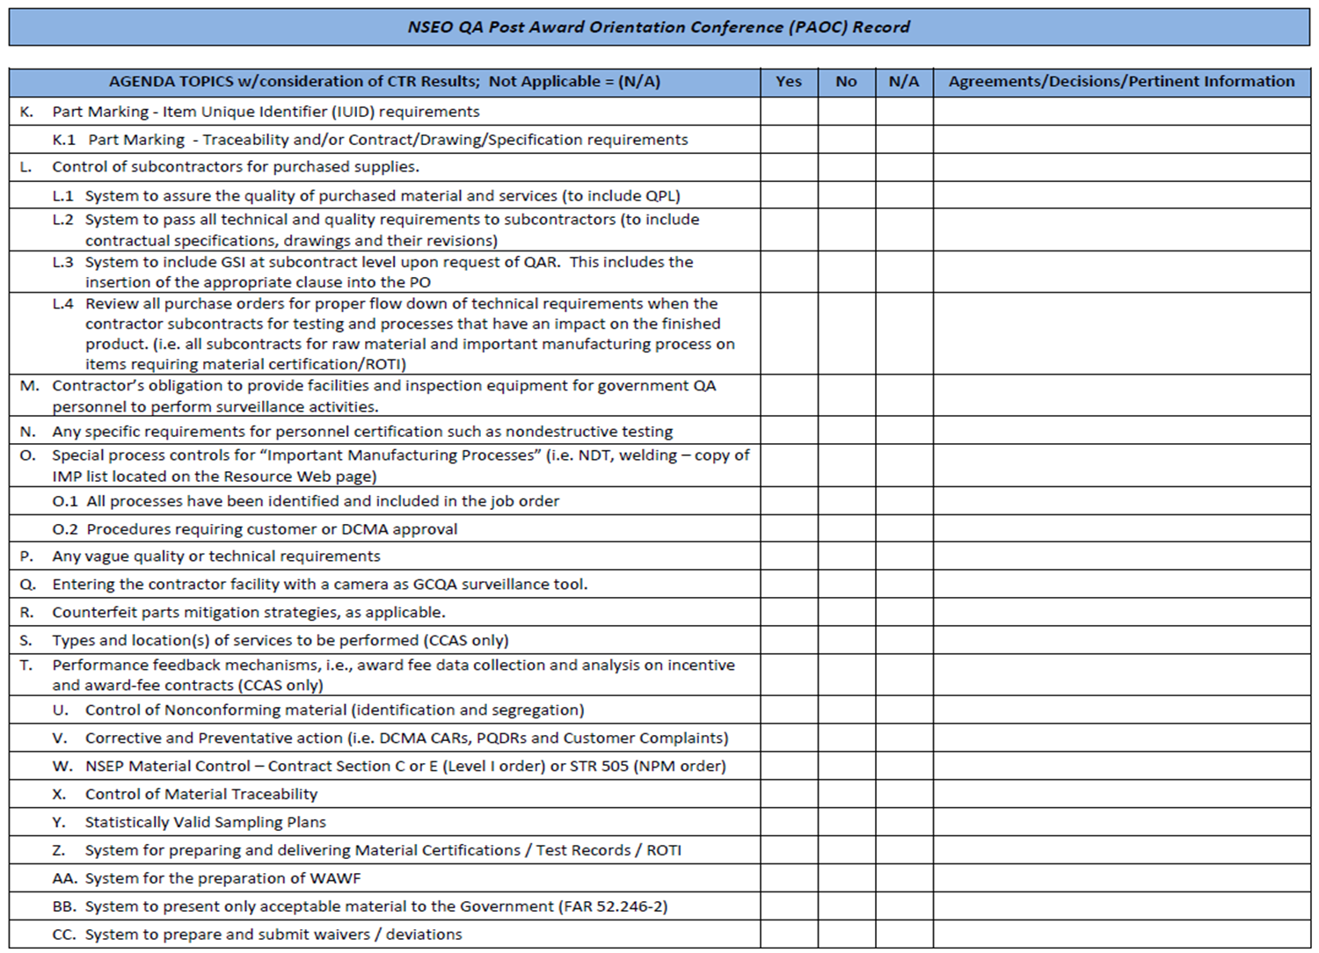
PAOC Documentation

Slide 39
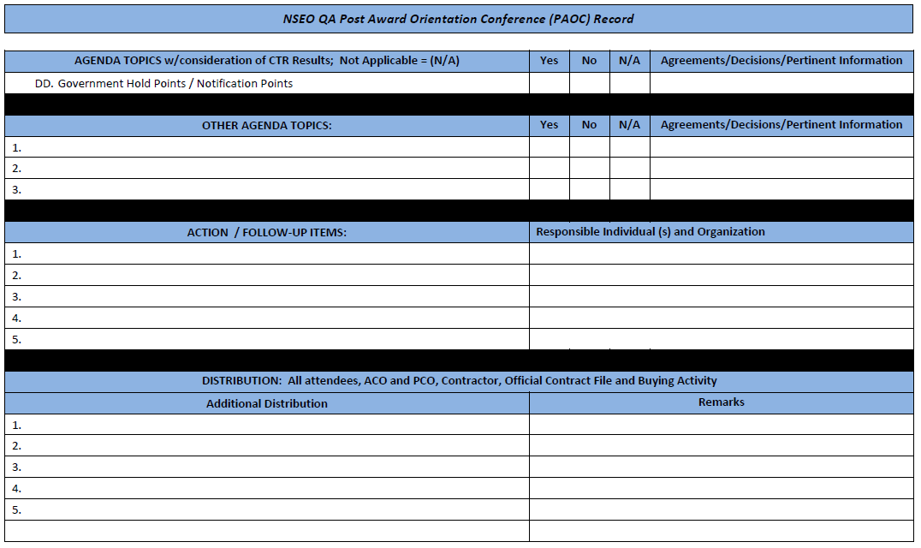
PAOC Documentation

Slide 40
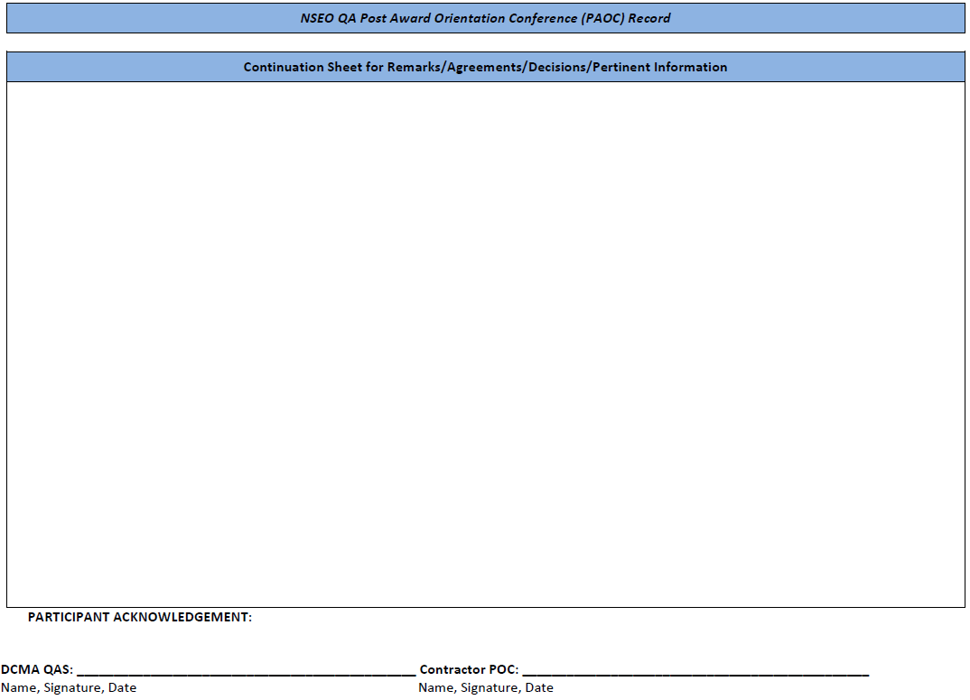
PAOC Documentation

Slide 41

Questions

Slide 42
Contacts
NAVSUP Assigned Contracting Officer
  Contract Pg 2, “NOTES” & Sec. G
Assigned QA – DCMA Quality Assurance Rep.
  Determined by DCMA Contract Management Database

Slide 43
NAVSUP WSS PAOC
THANK YOU FOR PARTICIPATING IN THIS POSTAWARD WEBINAR PRESENTATION!
Have a great day!

