Slide 1
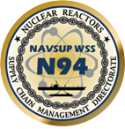
Nuclear Reactors Supply Chain Management Directorate (N94)
Vendor Information Portal & Education Resource
(VIPER)
Presented by:
LT Mark “Ben” McKeon, USN
Mrs. Janelle Houser N943 Supervisor
Ready! Resourceful! Responsive!

Slide 2
Agenda
VIPER Background
Vendor Benefits
VIPER Demonstration
Explore/Questions

Slide 3
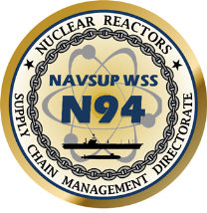
VIPER BLUF
What is VIPER:
High Velocity Training Initiative (HVTI), that will operate as a Virtual Supplier Conference
VIPER houses all non sensitive procurement information specific to N94
An educational resource for our current vendor community or those seeking opportunities
Database that allows the vendor to provide accurate and up-to-date points of contact for their organization.
Why VIPER:
Streamline and harmonize communication with vendor base
Single entry point for direct communication between the vendor and government Contract Specialist

Slide 4
Vendor Benefits
General Business Guide
Registration process describing how to sign up to work with N94
How to do sustainable procurement with N94
Lists of N94 activities and POC’s
Forecasted procurements
Link to external procurement sites (e.g. FBO, NECO)

Slide 5
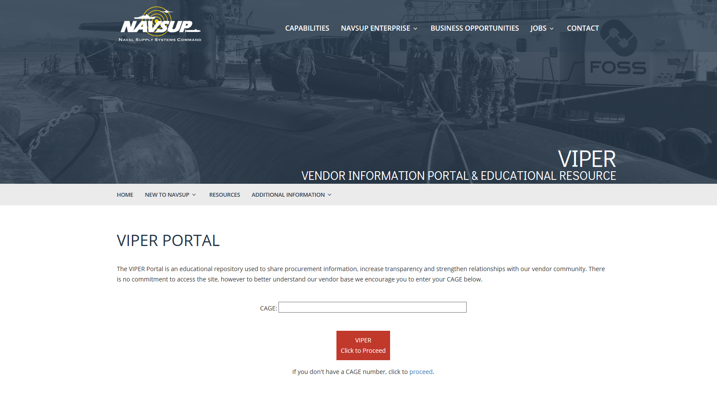
Click Here
https://www.navsup.navy.mil/navsup/ourteam/navsupwss

Slide 6
Please Enter CAGE Code and Click Proceed

Slide 7
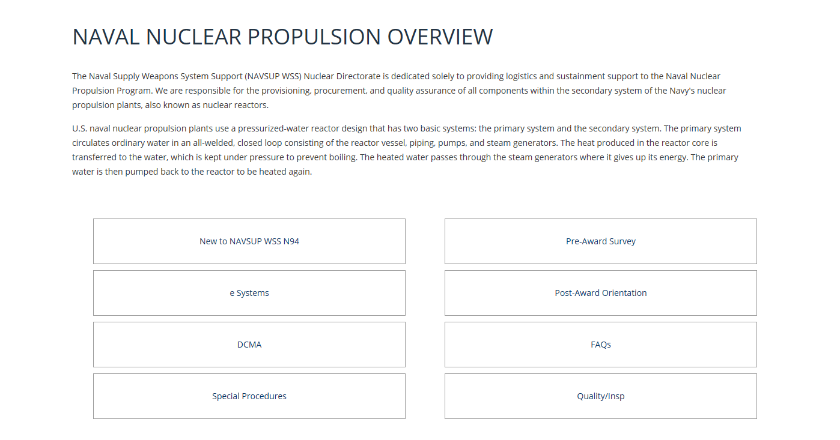
VIPER Content Page

Slide 8
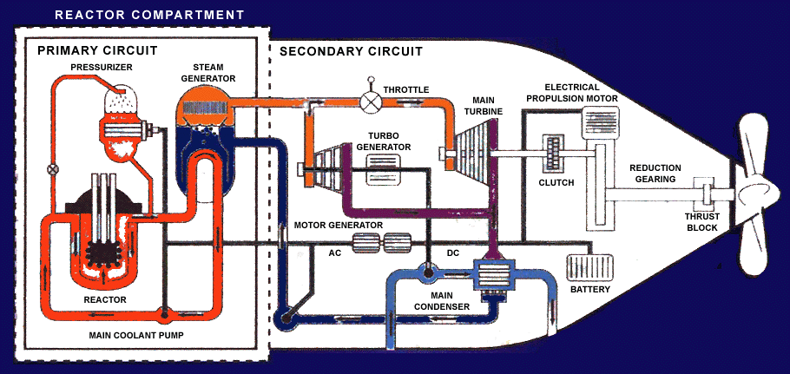
New to NAVSUP WSS N94
NAVAL NUCLEAR PROPULSION OVERVIEW
U.S. naval nuclear propulsion plants use a pressurized-water reactor design that has two basic systems: the primary system and the secondary system. The primary system circulates ordinary water in an all-welded, closed loop consisting of the reactor vessel, piping, pumps, and steam generators. The heat produced in the reactor core is transferred to the water, which is kept under pressure to prevent boiling. The heated water passes through the steam generators where it gives up its energy. The primary water is then pumped back to the reactor to be heated again. Inside the steam generators, the heat from the primary system is transferred across a watertight boundary to the water in the secondary system, also a closed loop. The secondary water (which is at relatively low pressure) boils, creating steam. Isolation of the secondary system from the primary system prevents water in the two systems from intermixing, keeping radioactivity out of the secondary water. In the secondary system, steam flows from the steam generators to drive the main propulsion turbines (which turn the ship’s propellers) and the turbine generators (which supply the ship with electricity). After passing through the turbines, the steam condenses back into water, and feed pumps return it to the steam generators for reuse. Thus, the primary and secondary systems are separate, closed systems in which continuously circulating water transforms the heat produced by the nuclear reaction into useful work (such as propulsion or electricity). No step in this process requires the presence of air or oxygen. This, combined with the ship’s ability to produce oxygen and purified water from seawater, allows a submarine to operate completely independent of the Earth’s atmosphere for extended periods of time. In fact, the length of a submerged submarine patrol is limited primarily by the amount of food the ship can carry for the crew.
New to NAVSUP
(quick links to content)
Pre-Award Survey
E-Business Systems
Special Procedures
NOFORN
Waivers & Deviations
Packaging & Packing
Post-Award Orientation
Quality Inspection
Additional Information
Glossary/ Acronyms
FAQ’s
Points of Contact

Slide 9
Pre-Award Survey
The Pre-Award Survey will be conducted by DCMA NSEO, NAVSUP WSS Quality Assurance Specialists, and Nuclear Engineers from the Cognizant Design Agent. The pre-award survey process concludes with a recommendation to the Nuclear Procurement Division regarding the prospective supplier’s ability to fulfill all the terms of a nuclear contract. The following are some of the factors that are the focus of Pre-Award Surveys:
Quality Assurance: Can you comply with the quality requirements invoked? A major portion of the Nuclear Directorate Pre-Award Survey will be focused on this factor.
Technical Capability: Do your key management personnel have the knowledge and experience needed to generate the required product or service?
Production Capability: Do you have – or can you acquire – the facilities, material, equipment, and personnel needed to complete the contract on time? Can you plan, control, and integrate each of these? Do you have a system for timely placement of orders and for vendor follow-up and control?
Finance: Do you have access to enough money to acquire needed facilities, material, equipment, and personnel?
Government Property Control: Are you capable of managing and controlling government property?
Packaging: Do you have the equipment and personnel to meet all of the packing and shipping requirements of the contract, such as marking, unitizing, and preservation?
Security: Do you and your employees have up-to-date, adequate clearances? The Defense Security Service conducts such evaluations when required.
Plant Safety: Can you comply with all federal, state, and local safety requirements?
Other: Additional special requirements may be included in the contract.
Potential suppliers should ask themselves the following questions prior to a Pre-Award Survey.
Have you chosen a management official to speak for your company?
Is that management official totally familiar with the contract and the higher level quality requirements invoked?
Does your quality system have adequate process controls, ensure material traceability, and properly segregate non-conforming material?
Can you demonstrate your company’s technical capability or the development of such a capability to generate the contracted product?
Is your company’s production plan adequate to meet the contract schedule? Is the plan available for review by the survey team?
Are your plant facilities and equipment available and operable?
Can your company meet the contract’s packaging, packing, and preservation requirements, no matter how unusual?
Do your company’s employees have up-to-date security clearances, and are the cleared for the proper level of secrecy?
Has your company hired enough properly skilled personnel?
Does your company have documents – previous government or commercial contracts and orders – that demonstrate a satisfactory record of on-time deliveries of quality products?
Have you made plans to escort the survey team through your facility? Are technical experts available to answer questions from the team?
Have you gathered pertinent financial documents – a profit and loss summary, a balance sheet, a cash flow chart, and so forth?
Do you have a list of on-hand tools and equipment? Is your measuring and test equipment properly calibrated?
Have you made verifiable plans for vendor supplies and materials for subcontracts? Do you have a follow-up system to ensure that your company can meet the delivery schedule if a vendor has problems? Do your subcontractors have a quality system compliant with the contract requirements? Do you have quality records available for the government to review upon request?
Do you understand all the requirements for technical data and publications?
Do you have any other information or data that the pre-award survey team would find useful?

Slide 10
E-Business Systems
Contractors choosing to do business with NAVSUP WSS will need to access to the following e-business procurement and technical systems.
System for Award Management (SAM) (Pre-Award)
SAM is a federal government-wide procurement system that (1) acts as a single authoritative data source for vendor, contract award and reporting information. Vendors must be registered in SAM to receive a Government contract. See the following link for additional information – https://www.sam.gov/portal/public/SAM/
Bechtel Plant Machinery, Inc. (BPMI) Online E-commerce (Pre-Award)
NAVSUP WSS Nuclear Directorate, along with BPMI, has developed a website that will assist with the procurement of items for the Navy Nuclear Propulsion Program. This website is called BPMI Online E-commerce and serves as a secure database for all unclassified IRPOD and drawing documents. Vendors must have access to BPMI Online in order to view the appropriate technical information associated with most nuclear procurements.
IRAPT/ Wide Area Workflow (WAWF) (Post- Award)
WAWF is a secure web based system for electronic invoicing, receipt, and acceptance. WAWF allows government vendors to submit and track invoices and receipt/acceptance documents over the web and allows government personnel to process those invoices in a real-time, paperless environment. Vendors must have access to WAWF to process a NAVSUP WSS contract. See the following links for additional information
https://wawf.eb.mil/
https://wawf.eb.mil/xhtml/unauth/web/homepage/vendorGettingStartedHelp.xhtml
Electronic Document Access (EDA) (Post-Award)
EDA provides vendors a "view-only" capability of contract documents that match their validated DUNS or CAGE codes. Access to EDA is recommended so that vendors can view their latest contract documents in real-time. See the following link for additional information – http://eda.ogden.disa.mil/

Slide 11
Special Procedures
INDIVIDUAL REPAIR PART ORDERING DATA (IRPOD)
A Myriad of Nuclear item requirements are detailed in a document called an IRPOD. IRPODs are prepared by the Cognizant Design Agents (CDA) Engineers to control or reference the technical requirements for repair parts and components in support of the nuclear program. They are structured similar to a military specification and include six sections. The contents of each section will be discussed separately below.
1.0 Scope
The scope provides a general overview for a vendor to interpret the IRPOD requirements. It identifies whether an item is a piece part or an assembly, and whether classified documents will apply.
2.0 List of Applicable Documents
Section 2.0 provides a consolidated list of documents referenced in the IRPOD. Identified are the standards, specifications, drawings, technical manuals and their respective revision levels that may be used to manufacture the nuclear repair part. Also identified are any documents that contain Not Releasable to Foreign Nationals/Governments/Non-US Citizens (NOFORN) information.
3.0 Technical Requirements
The Technical Requirements section includes both the material requirements (section 3.1) and the manufacturing process requirements (section 3.2) that apply to a specific repair part. CDA Engineers may modify, add, or delete requirements of the referenced drawings and/or specifications in this section of the IRPOD. The following are some examples of specific nuclear fastener requirements that may apply.
Chemical property testing.
Mechanical property testing to include wedge tensile testing for headed fasteners, proof load testing for nuts and hardness testing as required.
Zinc phosphate coating per MIL-DTL-16232.
Locking elements per MIL-DTL-18240.
Verification of critical characteristics and dimensions of the fastener to include overall length, head height, thread form, width across flats, width across corners, etc.
Non-Destructive Testing (NDT) such as Liquid Penetrant inspection to MIL-STD-271/Tech Pub 271 with acceptance criteria to MIL-STD-2035, class 1.
Decarburization testing.

Slide 12
Special Procedures cont’d
INDIVIDUAL REPAIR PART ORDERING DATA (IRPOD)
4.0 Quality Assurance Provisions
The Quality Assurance Provision section describes or references the quality assurance systems the vendor must maintain in order to supply the nuclear repair part. Also included in this section may be requirements for First Article Testing (FAT) or Production Lot Testing (PLT). FAT is performed to validate the vendor has the manufacturing capability, process and facilities to produce a product in accordance with the requirements of the contract. PLT is performed to verify that the manufacturer can and has maintained the manufacturing capability, process and facilities to produce a product in accordance with the requirements throughout the entire life of the contract. Both testing conditions may be performed by the Government and/or contractor, and may be invoked or referenced in other sections of the IRPOD.
5.0 Preparation for Delivery
The Preparation for Delivery section details the special packing and packaging requirements that apply to a specific repair part. Basic packing and packaging requirements are detailed in the schedule section of each order. ** See Packaging & Packing below for additional information.
6.0 Contract Data Requirements
The Contract Data Requirements section gives the buyer, supplier, and contract administration office a list of the technical data which the supplier must submit as a deliverable under each order. Some repair parts may require the submittal of Records of Test and Inspection (ROTIs), Manufacturing Procedures, or a Certificate of Compliance (COC).
Additional Resources
Waivers & Deviations
Packaging & Packing

Slide 13
Waivers & Deviations
Waivers & Deviations
Compliance with the technical requirements of the NAVSUP WSS IRPOD is expected. Any intended use of any material which is not in full compliance with the specified technical requirements should be identified as an exception in advance prior to manufacture.
Requests for waivers and de deviations from the technical requirements invoked should provide justification for the requested change including an evaluation which demonstrates that proposed non-conformance will not affect the quality, form, fit, or function of the part. Where a proposed alternate or replacement item is offered, supporting technical data (catalog page, drawing(s), etc.) that fully describe the proposed item shall be provided for technical evaluation. Requests which do not contain this information will be returned and will not be submitted to engineering for review until sufficient justification is provided.
Acceptance or rejection of the proposed change will be provided upon completion of engineering review.

Slide 14
Packaging & Packing
Packaging & Packing
All NAVSUP WSS packaging codes are designed to a specific item or special program requirements and are formatted in accordance with MIL-STD-2073.
MIL-STD-2073 outlines standard processes for the development and documentation of military packaging, as distinct from commercial packaging. This standard covers methods of preservation to protect materiel against environmentally induced corrosion and deterioration, physical and mechanical damage, and other forms of degradation during storage multiple handling, and shipment of materiel in the defense transportation system.
NAVSUPWSSDA07 PRESERVATION, PACKING, AND MARKING
Local clause is included in all NAVSUP WSS Nuclear contracts and provides additional requirements for items entering the Navy’s distribution system. Packing, marking, palletized material, and additional special requirements are detailed in this clause.
Passive Radio Frequency Identification (RFID)
RFID is required for repair parts and components including kits, assemblies and subassemblies, repairable and consumable items required for maintenance support of all equipment that will be shipped to one of the locations listed at http://www.acq.osd.mil/log/rfid/.
Additional requirements may be required in section 5.0 of the IRPOD.

Slide 15
NOFORN
NOFORN
NOFORN is defined as information and/or hardware concerning the design, arrangement, development, manufacturing, testing, operation, administration, training, maintenance, and repair of the propulsion plants of Naval Nuclear Powered Ships, including the associated shipboard and shore-based nuclear support facilities. When NOFORN applies, appropriate safeguards must be proposed by the contractor, and approved by the Contracting Officer for Security for the safeguarding from actual, potential, or inadvertent release by the contractor, or any subcontractor, of any NNPI (NOFORN) in any form, classified or unclassified. Such safeguards shall ensure that only governmental and contractor parties, including subcontractors that have an established need-to-know, have access in order to perform work under a contract, and then only under conditions which assure that the information is properly protected. Access by foreign nationals or immigrant aliens is not permitted. A foreign national or immigrant alien is defined as a person not a United States citizen or a United States national. United States citizens representing a foreign government, foreign private interests or other foreign nationals, are considered to be foreign nationals for industrial security purposes and the purpose of this restriction. In addition, any and all issue or release of such information beyond such necessary parties, whether or not ordered through an administrative or judicial tribunal, shall be brought to the attention of the Contracting Officer for Security.

Slide 16
Post-Award Orientation
Post-Award Orientation Conference
The QAR conducts a post-award orientation conference on each NAVSUP WSS nuclear contract to aid both the government and contractor personnel in achieving a clear and mutual understanding of all the contract requirements invoked. The purpose of the meeting is to have a detailed discussion up front in order to reduce the number of contract performance issues that delay material delivery.
At a minimum the post-award conference should include a discussion on any subcontractor flow down requirements, applicable drawings, design data, manuals, specifications, pre-production requirements, qualification tests, specification interpretation, packaging and marking requirements, NOFORN compliance, and contract data deliverables. The QAR should also notify the supplier in writing of any required hold points in the production or manufacturing process; hold points allow the government to witness any important manufacturing processes, an opportunity to verify significant material characteristics, or address any special areas of concern.
Additional Resources
Corrective Action Requests (CARs)

Slide 17
Corrective Action Requests (CARs)
DCMA NSEO has a policy that when nonconformities associated with a supplier’s Quality Management System (QMS), processes or product characteristics are independently discovered by DCMA, the supplier shall be notified and requested to initiate corrective actions in accordance with the contract requirements. Product or process nonconformities may be evidence of a breakdown in the supplier’s QMS or inspection systems.
FAR 46.105(a) states that the contractor is responsible for carrying out its obligations under the contract by (1) controlling the quality of supplies, and (2) tendering to the Government for acceptance only those supplies that conform to the contract requirements.
FAR 46.106 states that when a contract is assigned for administration to the contract administration office cognizant of the contractor’s plant, that office, unless specified otherwise, shall perform all actions necessary to verify whether the supplies or services conform to the contract quality requirements.
There are four levels of Corrective Action Requests (CARs) that depend on the severity of the nonconformity, and the level of supplier management visibility required to adequately address corrective actions. CARs can be issued by any DCMA NSEO functional specialist to include the QAR, Industrial Specialist (IS), and the Administrative Contracting Officer (ACO).
Level I CARs are issued to the supplier management level responsible for taking corrective actions for a nonconformity that can be corrected on the spot, and where no further corrective action response is necessary.
Level II CARs are the minimum level for a nonconformity associated with critical characteristics. They are issued to the supplier management level responsible for initiating corrective actions when the contractual nonconformity cannot be corrected on the spot. Level II CARs may be issued to subcontractors, and may be coupled with contractual remedies such as charge for additional cost of inspection or test when prior rejection makes reinspection or retest necessary. The purpose of a Level II CAR is to help a supplier improve their QMS.
Level III CARs are issued to the supplier’s top management for serious contractual nonconformities, failure to respond to a Level II CAR that has been issued, and repeat Level II CARs which indicates inadequate root cause determinations. Level III CARs are issued by the DCMA NSEO ACO and may be coupled with contractual remedies to include reduction of progress payments, cost disallowances, business management systems disapprovals, and charge for additional cost of inspection or test when prior rejection makes reinspection or retest necessary. A Level III CAR is the DCMA NSEO Commander’s management tool to correct issues that need to be addressed.
Level IV CARs are issued to the supplier’s top management when a Level III CAR has been ineffective and when the contractual nonconformity is of a serious nature. Level IV CARs are issued by the DCMA NSEO ACO and may be coupled with contractual remedies to include suspension of progress payments, suspension of product acceptance activities, removal of QAR from facility, and charge for additional cost of inspection or test when prior rejection makes reinspection or retest necessary.
The supplier’s response to the CAR should (1) identify the causes of the nonconformity to include the root cause(s) and casual factors; (2) state the actions taken to correct the specific nonconformity; (3) state the actions taken or planned to eliminate the cause(s) and prevent recurrence of the nonconformity; (4) state whether other products are affected, including product already delivered to the customer; (5) state action taken to correct the weakness which allowed deficient product to be presented to the government for acceptance; and (6) state the target date(s) for implementation of planned actions.
DCMA NSEO will review the supplier’s corrective action response; verify implementation of the corrective action, and follow-up to validate the effectiveness of the corrective action. If the supplier’s corrective action is ineffective, then the corrective action request is resubmitted to the supplier. If the supplier’s corrective action is effective then the CAR is closed. The overall objective of the CAR process is to reduce the number of PQDRs.

Slide 18
Quality Inspection
All contracts issued by NAVSUP WSS Nuclear Directorate will include FAR Clause 52.246-2 which requires suppliers to maintain a quality system acceptable to the government, and allows the DCMA NSEO QAR access to the contractor’s facility for the purpose of inspection and product verification, commonly referred to as Government Source Inspection (GSI). When significant processes are sub-contracted to other facilities, GSI may need to be included in purchase orders or service agreements to permit government oversight and/or inspection at the sub-contractor facility. As a minimum, a quality system acceptable to the government for NAVSUP WSS Nuclear Directorate contracts includes documented procedures for product verification, including calibration records for inspection equipment and records associated with product verification, documented review of sub-tier supplier capability and a documented process for managing non-conforming material. NAVSUP WSS will request DCMA conduct a pre-award survey to verify quality system acceptability.
Depending on the specific application of nuclear material, higher level contract quality requirements may be invoked. The following may apply:
International Organization for Standardization -- ISO 9000 Quality Management Series
ISO standards outlines principals and guidance for implementing a quality system which assures products consistently meet customer requirements. When a higher level contract quality requirement is invoked, NAVSUP WSS contracts will include Supplemental Technical Requirements (STR) which augments the ISO standards by adding additional requirements which must be observed for our orders. Certification to ISO standards by a third party is not required for NAVSUP WSS contracts. Companies who do not have manuals consistent with ISO principals may elect to follow MIL-I-45208 or MIL-Q-9858.
MIL-I-45208 - This military specification, though canceled, establishes requirements for the inspection system and tests used to substantiate product conformance. Like ISO, it outlines requirements for documentation, records and process controls with the intent of ensuring product meets customer requirements.
ISR-1 - This document supplements MIL-I-45208 by adding additional requirements for the qualification of inspection and test personnel, inspection system audits, Identity of records and recorded characteristics.
MIL-Q-9858 - This military specification requires the establishment of a quality program to assure adequate quality throughout all areas of contract performance such as design, development, fabrication, processing, assembly, inspection, test maintenance, packaging, shipping, storage and site installation.
QRC-82 - This document supplements MIL-Q-9858 by adding additional requirements for the qualification of inspection and test personnel, inspection system audits, Identity of records and recorded characteristics.
IQE-1 - Integrated Quality Engineering Specification establishes specific requirements for Naval Nuclear products, including control of critical product characteristics throughout the planning and manufacture of the product.
MIL-DTL-45662 - This military specification outlines the requirements for maintaining a calibration system to monitor the equipment utilized for product inspection. Typically companies have the option to follow ISO 10012.

Slide 19
Report of Test and Inspection (ROTI)
ROTIs consists of a cover letter with a certification statement, along with test and inspection reports. The required reports will be defined in the IRPOD. Some examples are: certified mill test reports; tensile, hardness, non-destructive and hydrostatic test reports; dimensional inspections; chemical analysis; alloy identification; etc. ROTIs are submitted to NAVSUP WSS up to 30 days prior to the required material delivery date and must be approved before material can be shipped.
Some supplier manufacturing procedures need to be submitted to NAVSUP WSS prior to use for approval. Some examples are welding procedures, non-destructive testing procedures, special material cleaning procedures, and alloy identification procedures. Written procedures must be submitted to NAVSUP WSS within 45 days after contract award when applicable.
For all contracts that do not require a ROTI, a COC is required.
A COC is a one page certification that states all manufactured items are in compliance with the contract requirements. The COC is submitted to NAVSUP WSS at the same time as the parts are shipped.

Slide 20
Product Quality Deficiency Reports (PQDR)
PQDRs are the primary tool used for receiving feedback from material users on the state of systems and material issued through the supply system. The primary purposes of PQDRs are to report material non-conformances, provide a vehicle to recover material cost as a result of the non-conformance, and to take steps to prevent recurrence. Non-conformance deficiencies are any defect, condition, or premature equipment failure indicating deficiencies in design, specification, documentation, material, manufacturing, and workmanship.
PQDRs are classified as CATEGORY I or CATEGORY II. CATEGORY I include critical defects which may cause death, injury, severe illness, loss or major damage to a weapon system, and ultimately restrict combat readiness capabilities. CATEGORY II includes any major or minor defect which does not meet the criteria set forth in Category I.
In the event of a PQDR, the contractor will be expected to assist in the investigation to determine the root cause of any valid deficiencies; root cause is defined as what processes failed to allow the deficiency. Next contractors will be expected to develop and execute and valid corrective actions to resolve any valid deficiencies; corrective actions are defined as what the contractor and QAR are doing to correct the deficiency for this shipment. Then contractors will develop preventative actions to preclude recurrence of deficiencies; preventative actions are defined as what the contractor and QAR are doing to ensure the deficiency doesn’t happen again. Finally, the contractor is expected to keep the DCMA NSEO QAR informed of the status of the investigation and any rework, repair, or replacement of nonconforming material.

Slide 21
Glossary/ Acronyms
VIPER – Vendor Information Portal & Informational Repository
OSKR – Oral Solicitation Contract Repository
FELIX – Folder Execution and Latency Inquiry Exploration
GSI – Government Source inspection
DCMA – Defense Contract Management Agency
WAWF – Wide Area Work Flow
EDA - Electronic Document Access
NSEO – Navy Special Emphasis Operations
PQDR – Product Quality Deficiency Report
CAR – Corrective Action Report
ROTI – Report of Test and Inspection
IRPOD – Individual Repair Part Ordering Data

Slide 22
Points of Contact
Pre Award
MECH_NICPM_Code873@navy.mil
Technical
MECH_NICPM_Code873@navy.mil
Post Award - Please contact the Contract Specialist on page 2 of your contract.
MECH_NICPM_Code873@navy.mil

Slide 23
CY 17 Webinar Schedule

Slide 24
Questions
https://www.navsup.csd.disa.mil/public/navsup/viper/

